Slide 1
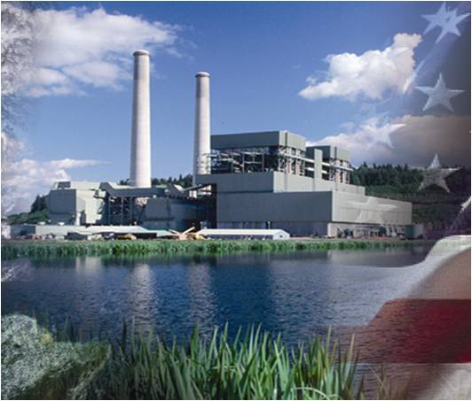
Bayesian Calibration of Reaction Rate Model Parameters in Reacting Multiphase Flow Simulations for Advanced Coal Gasifier Technology Development
Mehrdad Shahnam¹, Aytekin Gel^{1,2}, Arun K. Subramaniyan³, Jordan Musser¹, Jean F. Dietiker^{1,4}
¹Department of Energy, National Energy Technology Laboratory
²Alpemi Consulting, ³GE Global Research, ⁴WVURC
NETL Multiphase Flow Sciences Workshop
August 12-13, 2015 Morgantown, WV

Slide 2
Uncertainty Quantification
Motivation
There is a strong need to assess the credibility of numerical prediction results for wider acceptance in development of new technologies for fossil fuel based clean energy.
Verification, Validation and Uncertainty Quantification (VV&UQ) methods provide the required objective means in establishing the confidence level from simulation outcome.
Objective
Determine the best set of methods, techniques and software tools applicable for reactive multiphase flow simulation in order to assess the uncertainty in simulation results

Slide 3
The Need for Advanced Clean Energy Technologies for Fossil Fuels
Over 40% of electricity worldwide is generated through the use of coal
New environmental regulations, mandating reduction on green house gases and other pollutants will impact coal-based power plants
Coal gasification technology promises to generate power with reduced environmental impact
Department of Energy’s National Energy Technology Laboratory (NETL) has launched an R&D program to quantify uncertainty in model predictions for reacting gas-solids systems, such as a gasifier
The goal is to develop a practical framework to quantify the various types of uncertainties and assess the impact of their propagation in the computer models of the physical system

Slide 4
Approach
Non-intrusive UQ approach is selected in order to treat the the validated scientific simulation software as a black box without the need for structural changes.
Surrogate models of the quantities of interest (QoI) are created through sampling techniques and UQ analysis with Bayesian methodology is employed.
UQ analysis performed:
Forward propagation of input uncertainties to their effect on QoI,
Global sensitivity analysis,
Bayesian calibration.

Slide 5
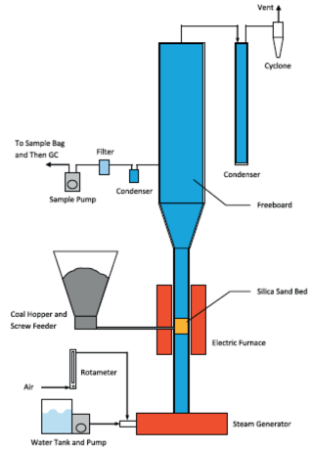
Transient Fluidized Bed Gasifier Simulation
Outlet
Uncertainty Quantification Study Properties:
Input parameters with Uncertainty [range] Coal Flow Rate (g/s) : [0.036 – 0.063] (2) Particle Size (μm) : [70 – 500] (3) H2O / O2 ratio : [0.5 – 1.0]
Quantities of Interest: Carbon Conversion (%) H2/CO CH4/H2 Species mole fractions at exit
Coal inlet
Air inlet
Schematic diagram of the lab-scale fluidized-bed gasifier used for experiments¹
(1)Shayan Karimipour, Regan Gerspacher, Rajender Gupta, Raymond J. Spiteri, “Study of factors affecting syngas quality and their interactions in fluidized bed gasification of lignite coal”, Fuel, Vol. 103, January 2013, Pages 308-320, ISSN 0016-2361, http://dx.doi.org/10.1016/j.fuel.2012.06.052.

Slide 6
Transient Fluidized Bed Gasifier Simulation
Transient CFD simulations performed with MFIX-TFM (https://mfix.netl.doe.gov )
Coal pyrolysis, combustion, steam & CO₂ gasification along with H₂, CO and CH₄ oxidation are modeled using 11 chemical reactions.
Total of 33 transport equations are simultaneously solved for transport of 21 species and three phases (gas, coal and sand).
Computational cost per sampling simulation:
2D : 2~3 weeks on 16 cores
3D (30x350x30) : 7~8 weeks on 96 cores

Slide 7
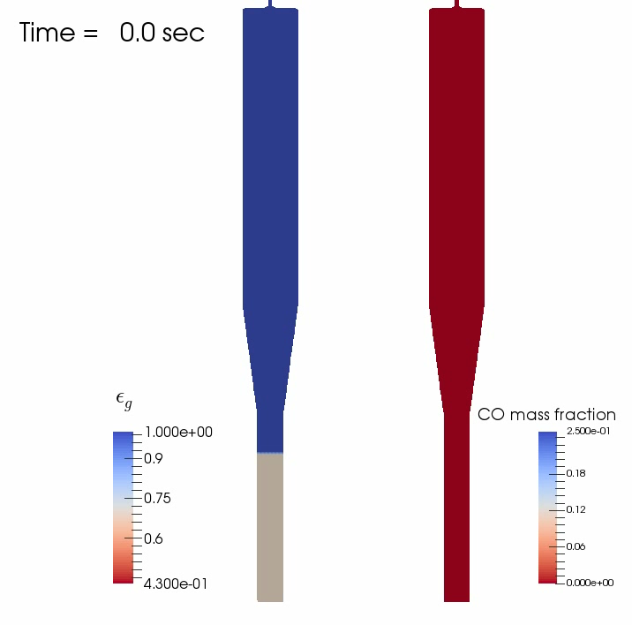
Animation of Voidage and CO Mass Fraction (2D slice of a 3D simulation)
Voidage Mass Fraction of CO

Slide 8
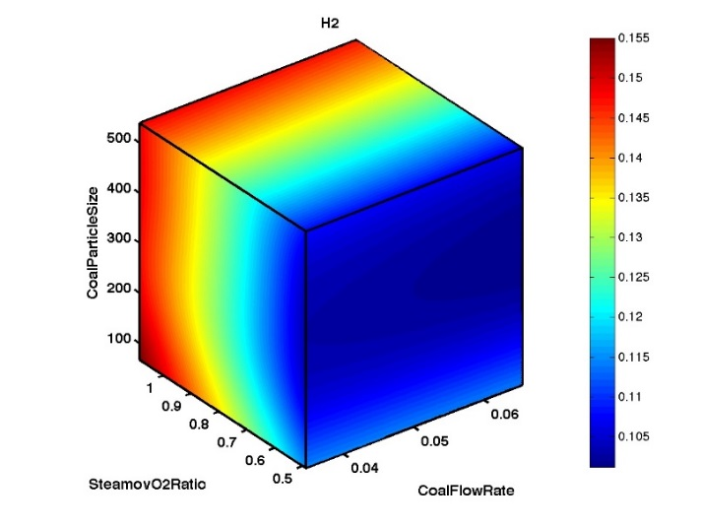
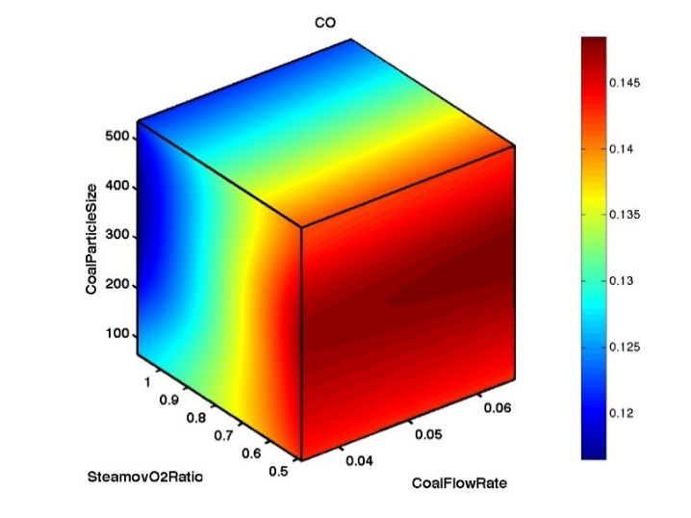
Surrogate Model
Surrogate models for H₂ and CO mole fraction, based on 30 samples of CFD runs and three uncertain input parameters.
Particle size (µm)
Particle size (µm)
H₂O/O₂
Coal flow rate (gr/s)
H₂O/O₂
Coal flow rate (gr/s)
Surrogate model for H₂ mole fraction
Surrogate model for CO mole fraction

Slide 9
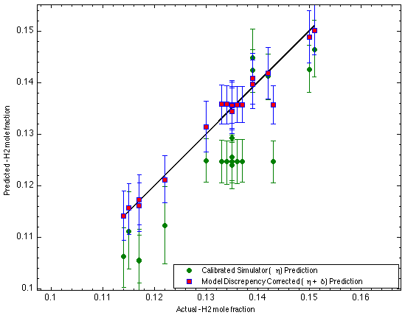
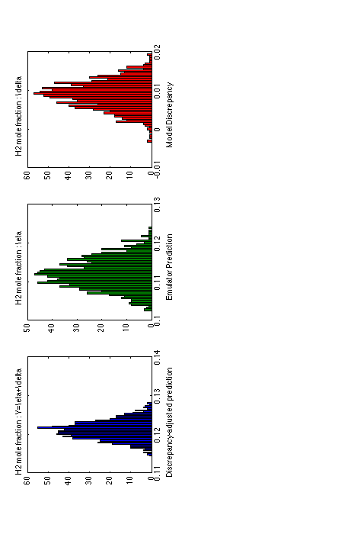
Parity Plot of H₂ Mole Fraction Surrogate Model Prediction, with Uncertainty vs. Experiment
Points on the line indicates perfect comparison between measured data and simulation results
Gaussian process model based model discrepancy
Prediction of
the emulator constructed from both simulation & experiments
Experimental Data = Simulation Results + Discrepancy

Slide 10
Parity Plot of H₂ Mole Fraction Surrogate Model Prediction, with Uncertainty, Corrected for Model Discrepancy vs. Experiment
Model discrepancy corrected emulator prediction of # 4
Experimental Data = Simulation Results + Discrepancy

Slide 11
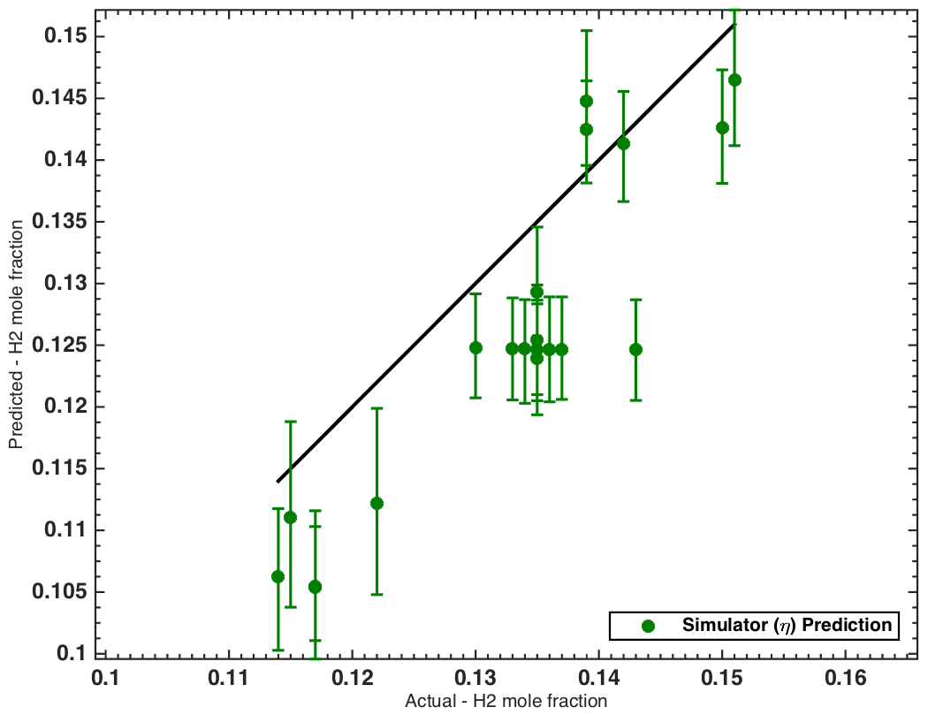
Parity Plot of H₂ Mole Fraction Surrogate Model Prediction, with Uncertainty vs. Experiment
Surrogate model prediction, with uncertainty interval
Hydrogen mole fraction is under-predicted across the entire parametric space

Slide 12
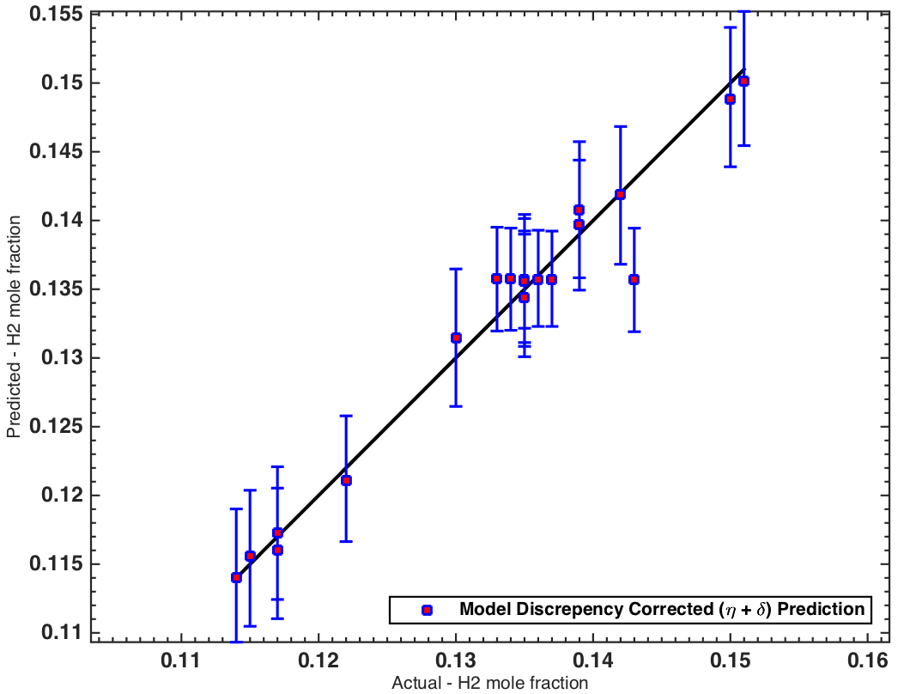
Parity Plot of H₂ Mole Fraction Surrogate Model Prediction, with Uncertainty, Corrected for Model Discrepancy vs. Experiment
Model discrepancy corrected prediction values of hydrogen mole fraction and their uncertainty intervals across the entire parameter space

Slide 13
Parity Plot of H₂ Mole Fraction Surrogate Model Prediction, with Uncertainty, Corrected for Model Discrepancy vs. Experiment
Prediction by the surrogate model (green)
Prediction by the surrogate model, corrected for the discrepancy (blue)

Slide 14
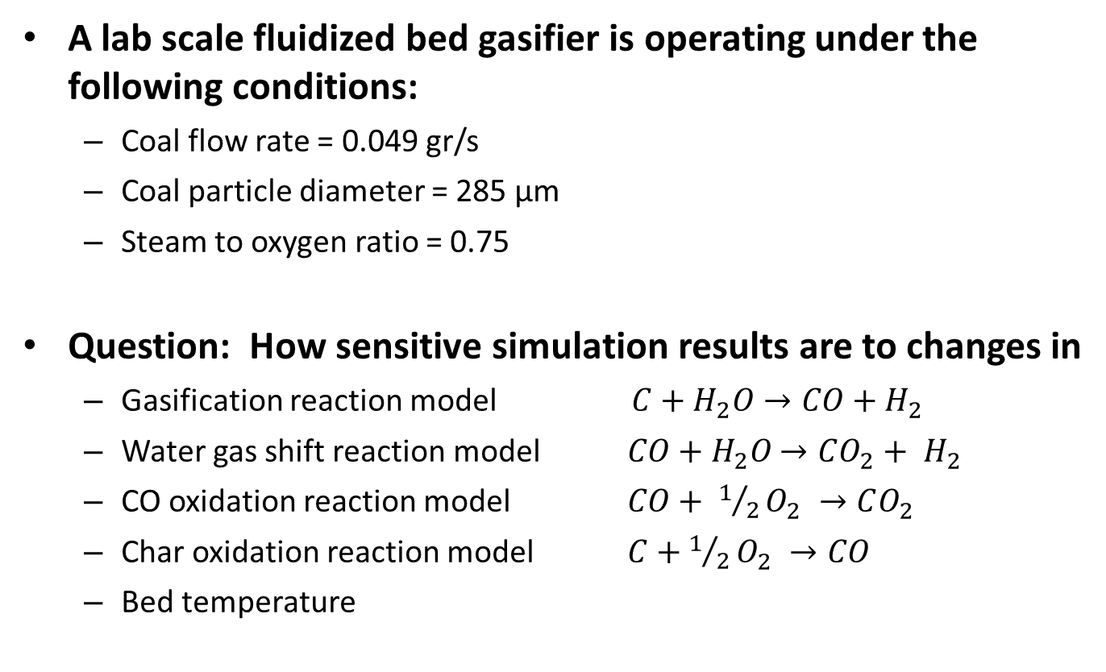
Global Sensitivity Analysis
A lab scale fluidized bed gasifier is operating under the following conditions:
Coal flow rate = 0.049 gr/s
Coal particle diameter = 285 µm
Steam to oxygen ratio = 0.75
Question: How sensitive simulation results are to changes in
Gasification reaction model $C+H_{2}O→CO+H_{2}$
Water gas shift reaction model $CO+H_{2}O$ $→CO_{2}+ H_{2}$
CO oxidation reaction model $CO+ 1/2O_{2} →CO_{2}$
Char oxidation reaction model $C+1/2O_{2} →CO$
Bed temperature

Slide 15
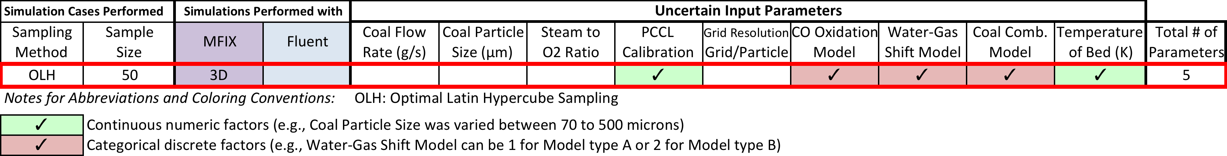
Global Sensitivity Analysis
Percent variability in CO, H₂ and CO₂ mole fraction due to changes in bed temperature and reaction models for water gas shift, gasification, CO oxidation and char oxidation.

Slide 16
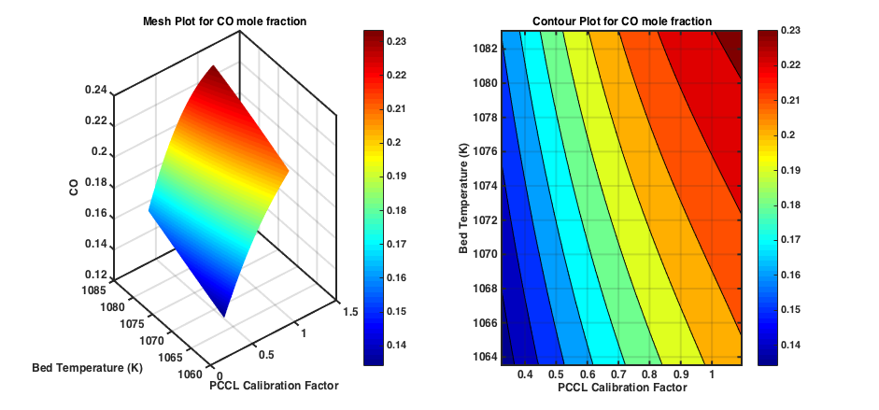
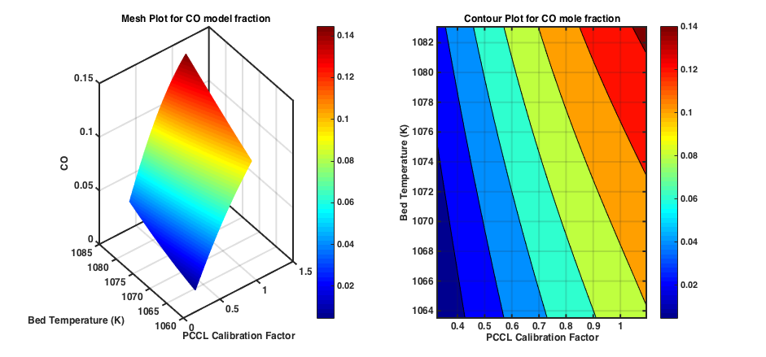
Surrogate Models Can Provide Insight in Trends
Variation in CO Mole Fraction due to Variation in Bed Temperature and Gasification Rate Constant
Top right: catalytic water gas shift reaction
Bottom right: non-catalytic water gas shift reaction
CO Mole Fraction values obtained by using catalytic water gas shift reaction is closer to the measured values (0.12 to 0.14)

Slide 17
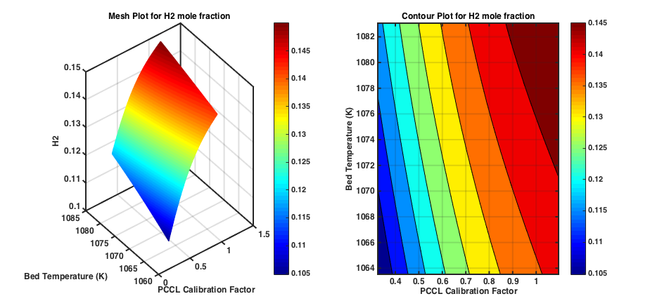
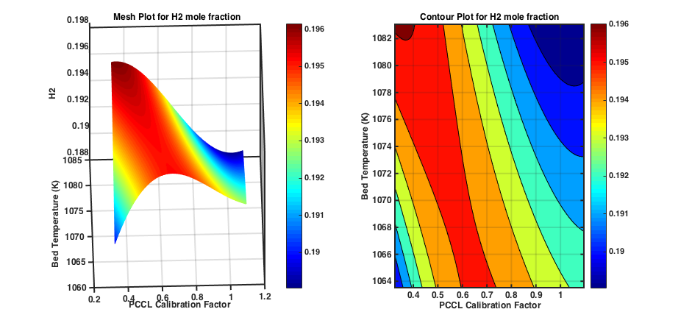
Surrogate Models Can Provide Insight in Trends
Variation in H₂ Mole Fraction due to Variation in Bed Temperature and Gasification Rate Constant
Top right: catalytic water gas shift reaction
Bottom right: non-catalytic water gas shift reaction
H₂ Mole Fraction values obtained by using catalytic water gas shift reaction is closer to the measured values (0.12 to 0.15)

Slide 18
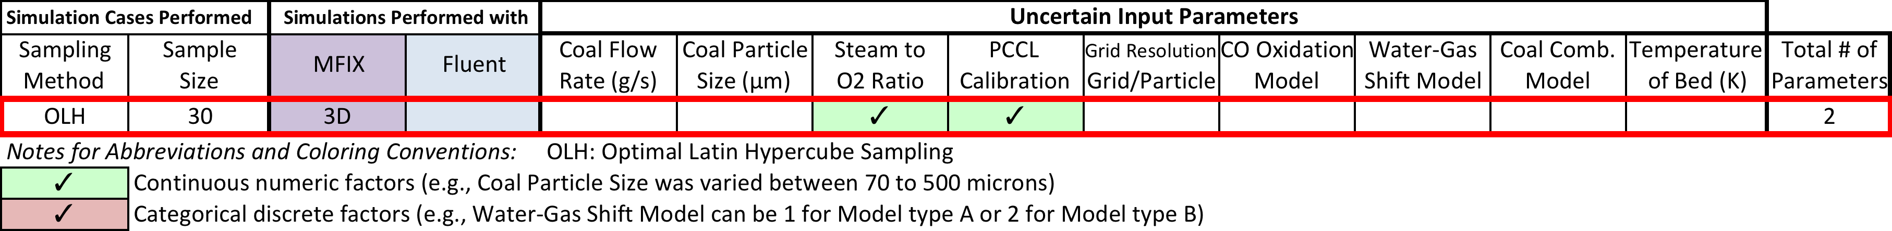
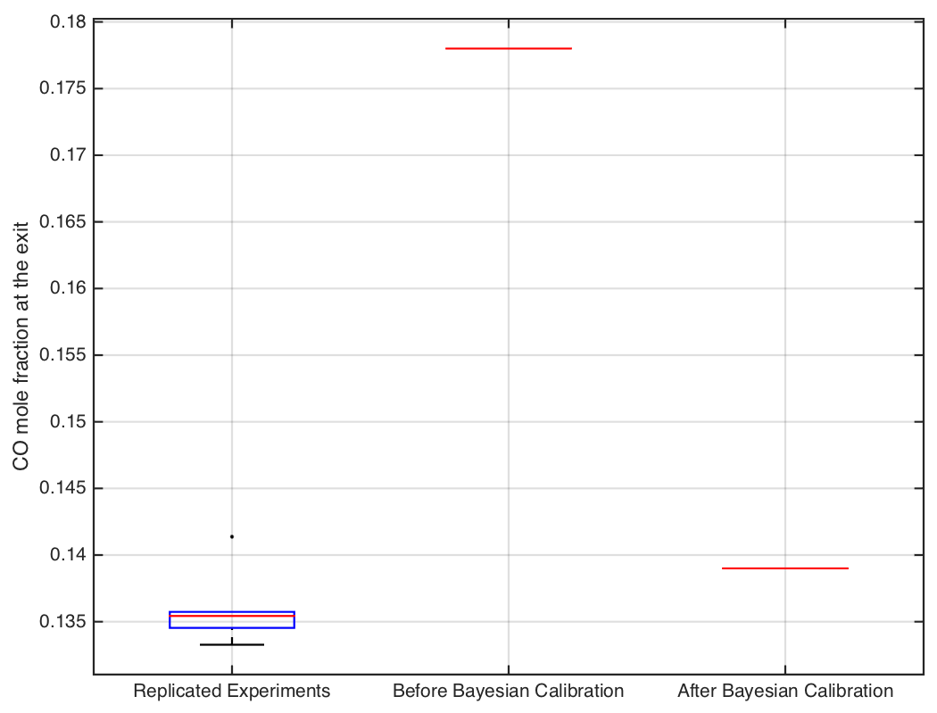
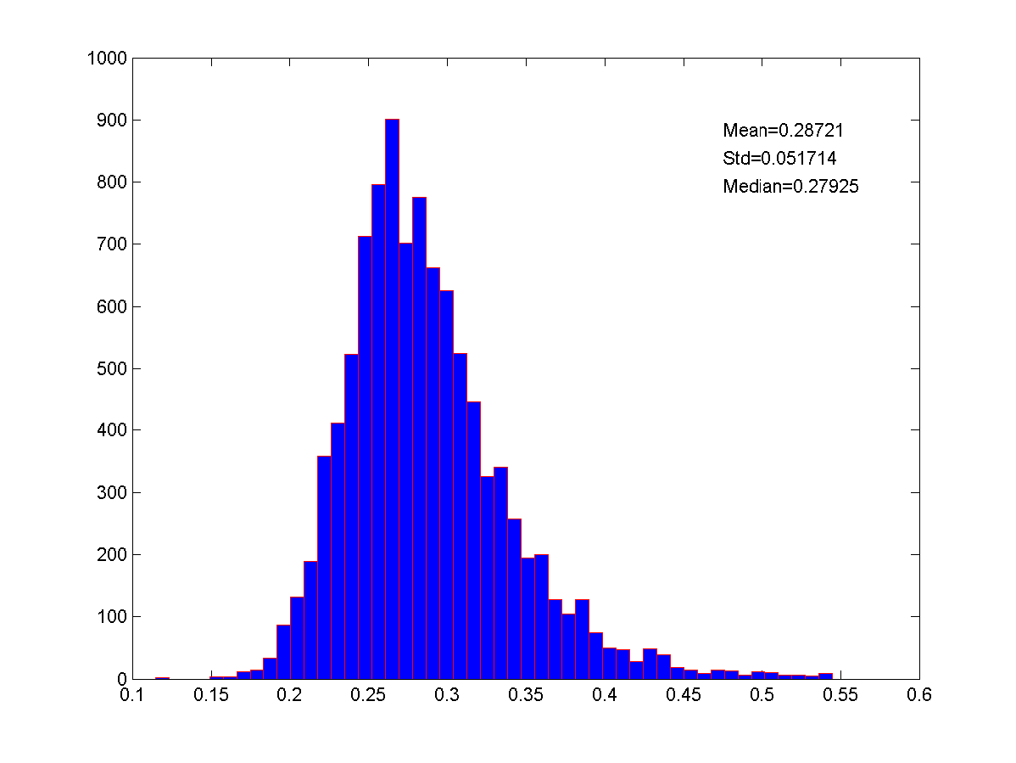
Bayesian Calibration
Posterior distribution for the multiplier to the gasification kinetics model (PCCL Calibration factor) obtained via Bayesian Calibration, when prior distribution was assumed to vary between [0.09 & 0.55]
MFIX Simulation Results before & after Bayesian Calibration for CO mole fraction

Slide 19
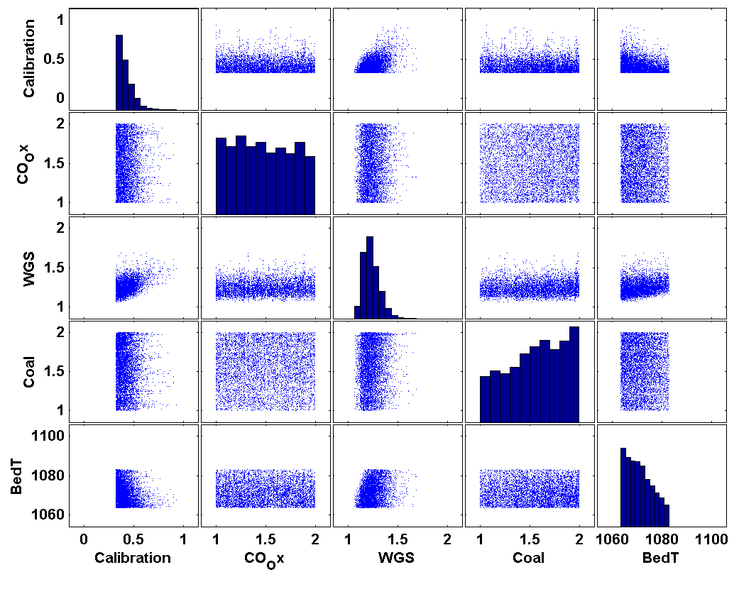
Bayesian Calibration
Posterior distribution for all five calibration parameters (PCCL Calibration factor, reaction models and bed temperature) obtained via Bayesian Calibration.
Bayesian Calibration Suggests the Following Parameter Settings:
PCCL = 0.398
Bed Temp. = 1070.5 K
WGS model = 1
Coal Comb. Model = 2
CO Oxid. Model = 1 or 2

Slide 20
Conclusions
Uncertainty Quantification analysis provided uncertainty intervals for the CFD simulation results in the parametric space tested.
Sensitivity Analysis points to the water gas shift reaction as being the most important reaction in effecting the syngas composition (CO and H₂)
Based on analysis of the surrogate models for CO and H₂, the catalytic water gas shift reaction is the suitable reaction to use for conversion of CO to H₂.
Bayesian Calibration provided a better assessment on one of the most uncertain model parameter, i.e., gasification rate constant and improvement in CFD results was demonstrated.
Sensitivity analysis shows that improvements in the catalytic water gas shift reaction model, gasification reaction model and heat transfer between gas and solid phases can lead to improvement in model prediction

Slide 21
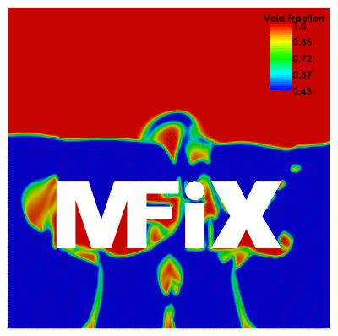
Computational Resources
Computational resources provided by:
The supercomputer facility at DOE-NETL
The ALCC program at the National Energy Research Scientific Computing Center (NERSC), a DOE Office of Science User Facility supported by the Office of Science of the U.S. Department of Energy under Contract No. DE-AC02-05CH11231.

